Slide 1
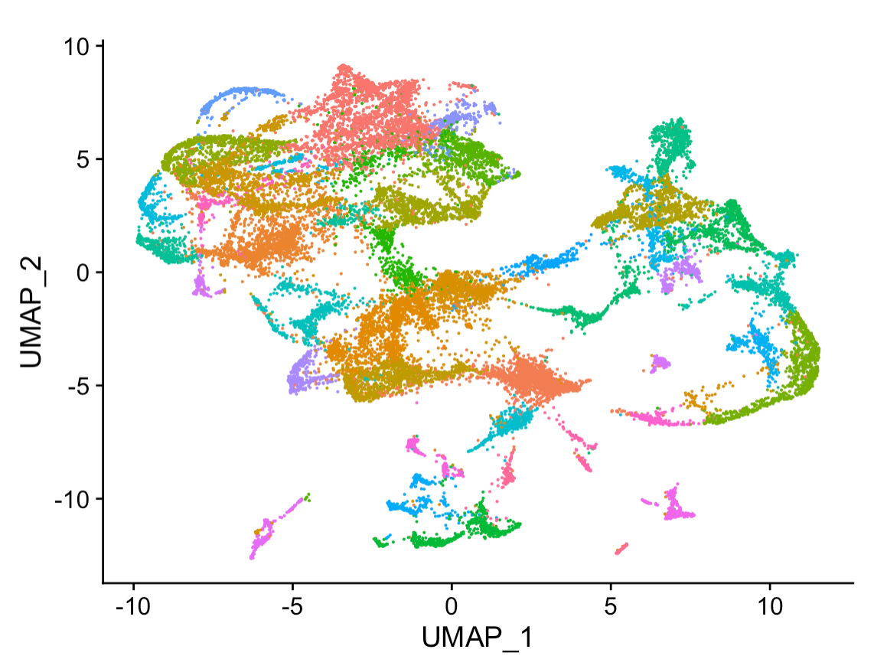
Good Data Practices For Machine Learning
Data4ML
Summer 2022

Slide 2
It’s All About Data
Good Machine Learning starts with good datasets
What makes a dataset ‘good’
Reproducible
‘FAIR’ – Finable Accessible Interoperable and Reusable
How to plan out your data taking
What makes a data set ‘AI-Ready’

Slide 3
Reminder
Clear Data Splits
Designate some examples as training data
Designate some examples as testing data
Structed Data is ‘Tidy’ - https://vita.had.co.nz/papers/tidy-data.pdf
Every column is a variable.
Every row is an observation.
Every cell is a single value
The Dataset is Clean
No missing values or ‘Nans’
No ‘bad’ data
Consistent as Possible

Slide 4
ML Data Content
ML models are programed with data
Beyond technical requirements the content of the data is important
What is in your data determines how your model works
Will it generalize
Will it be able to train
How accurate will it be

Slide 5
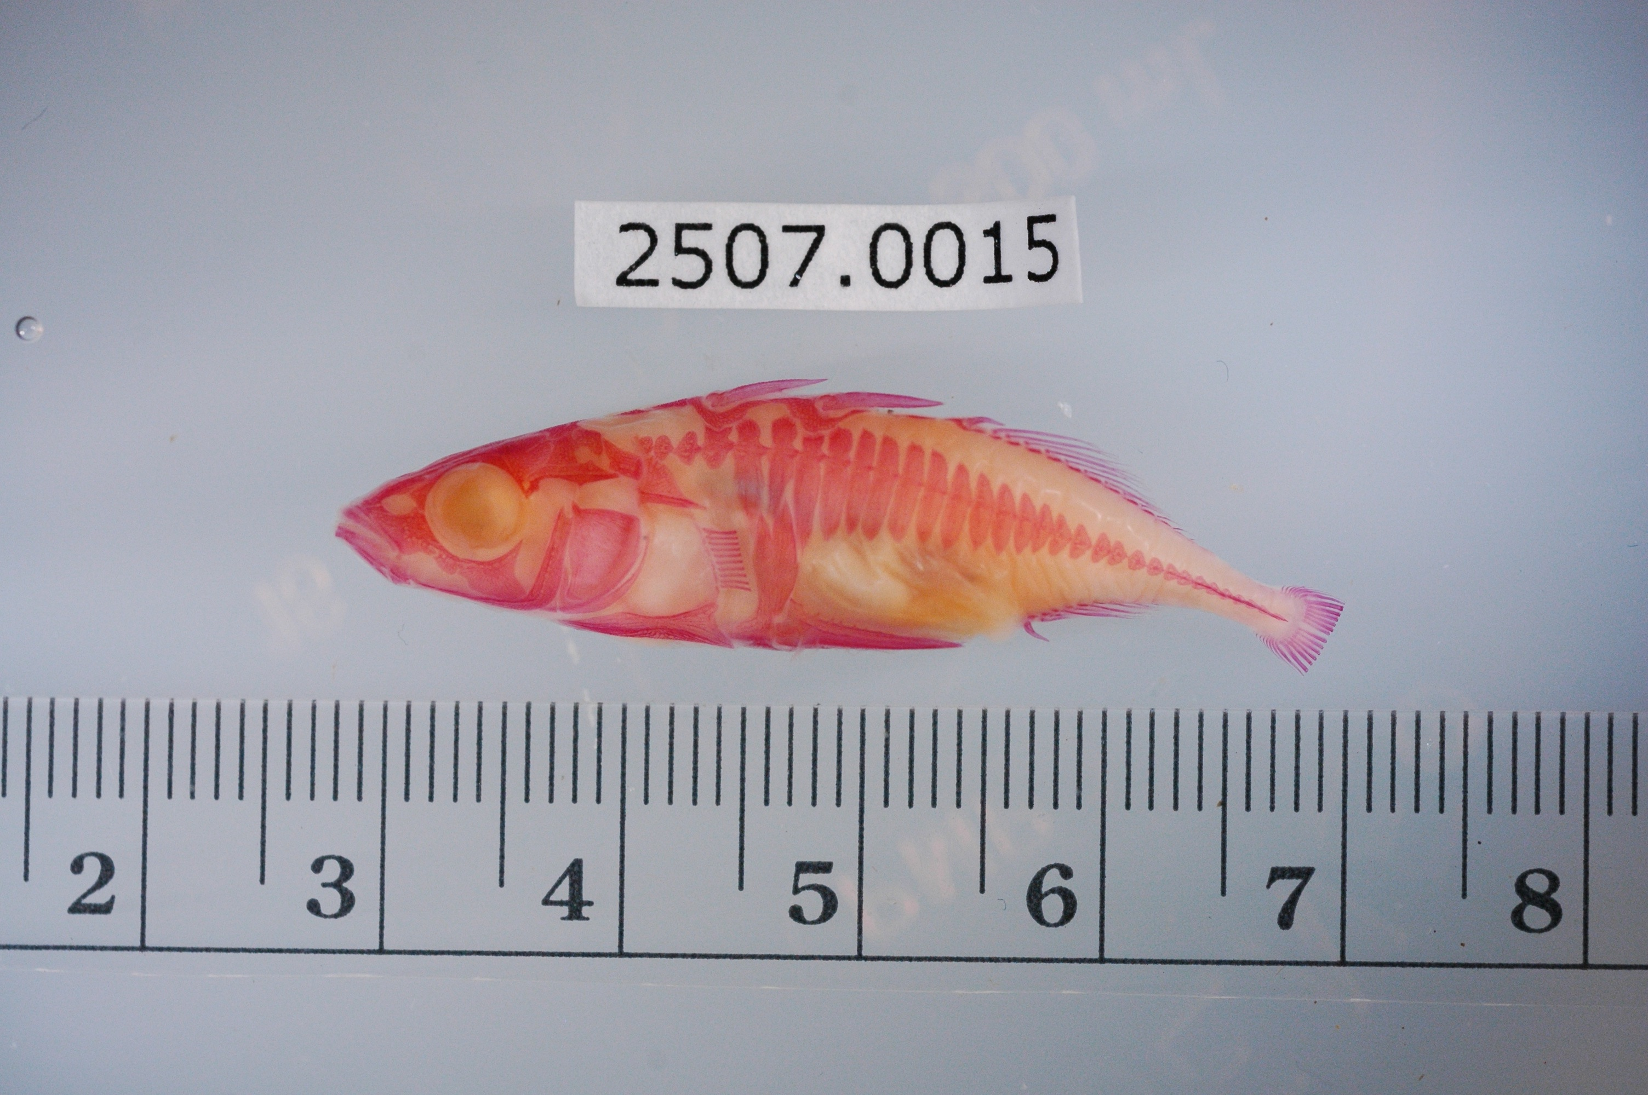
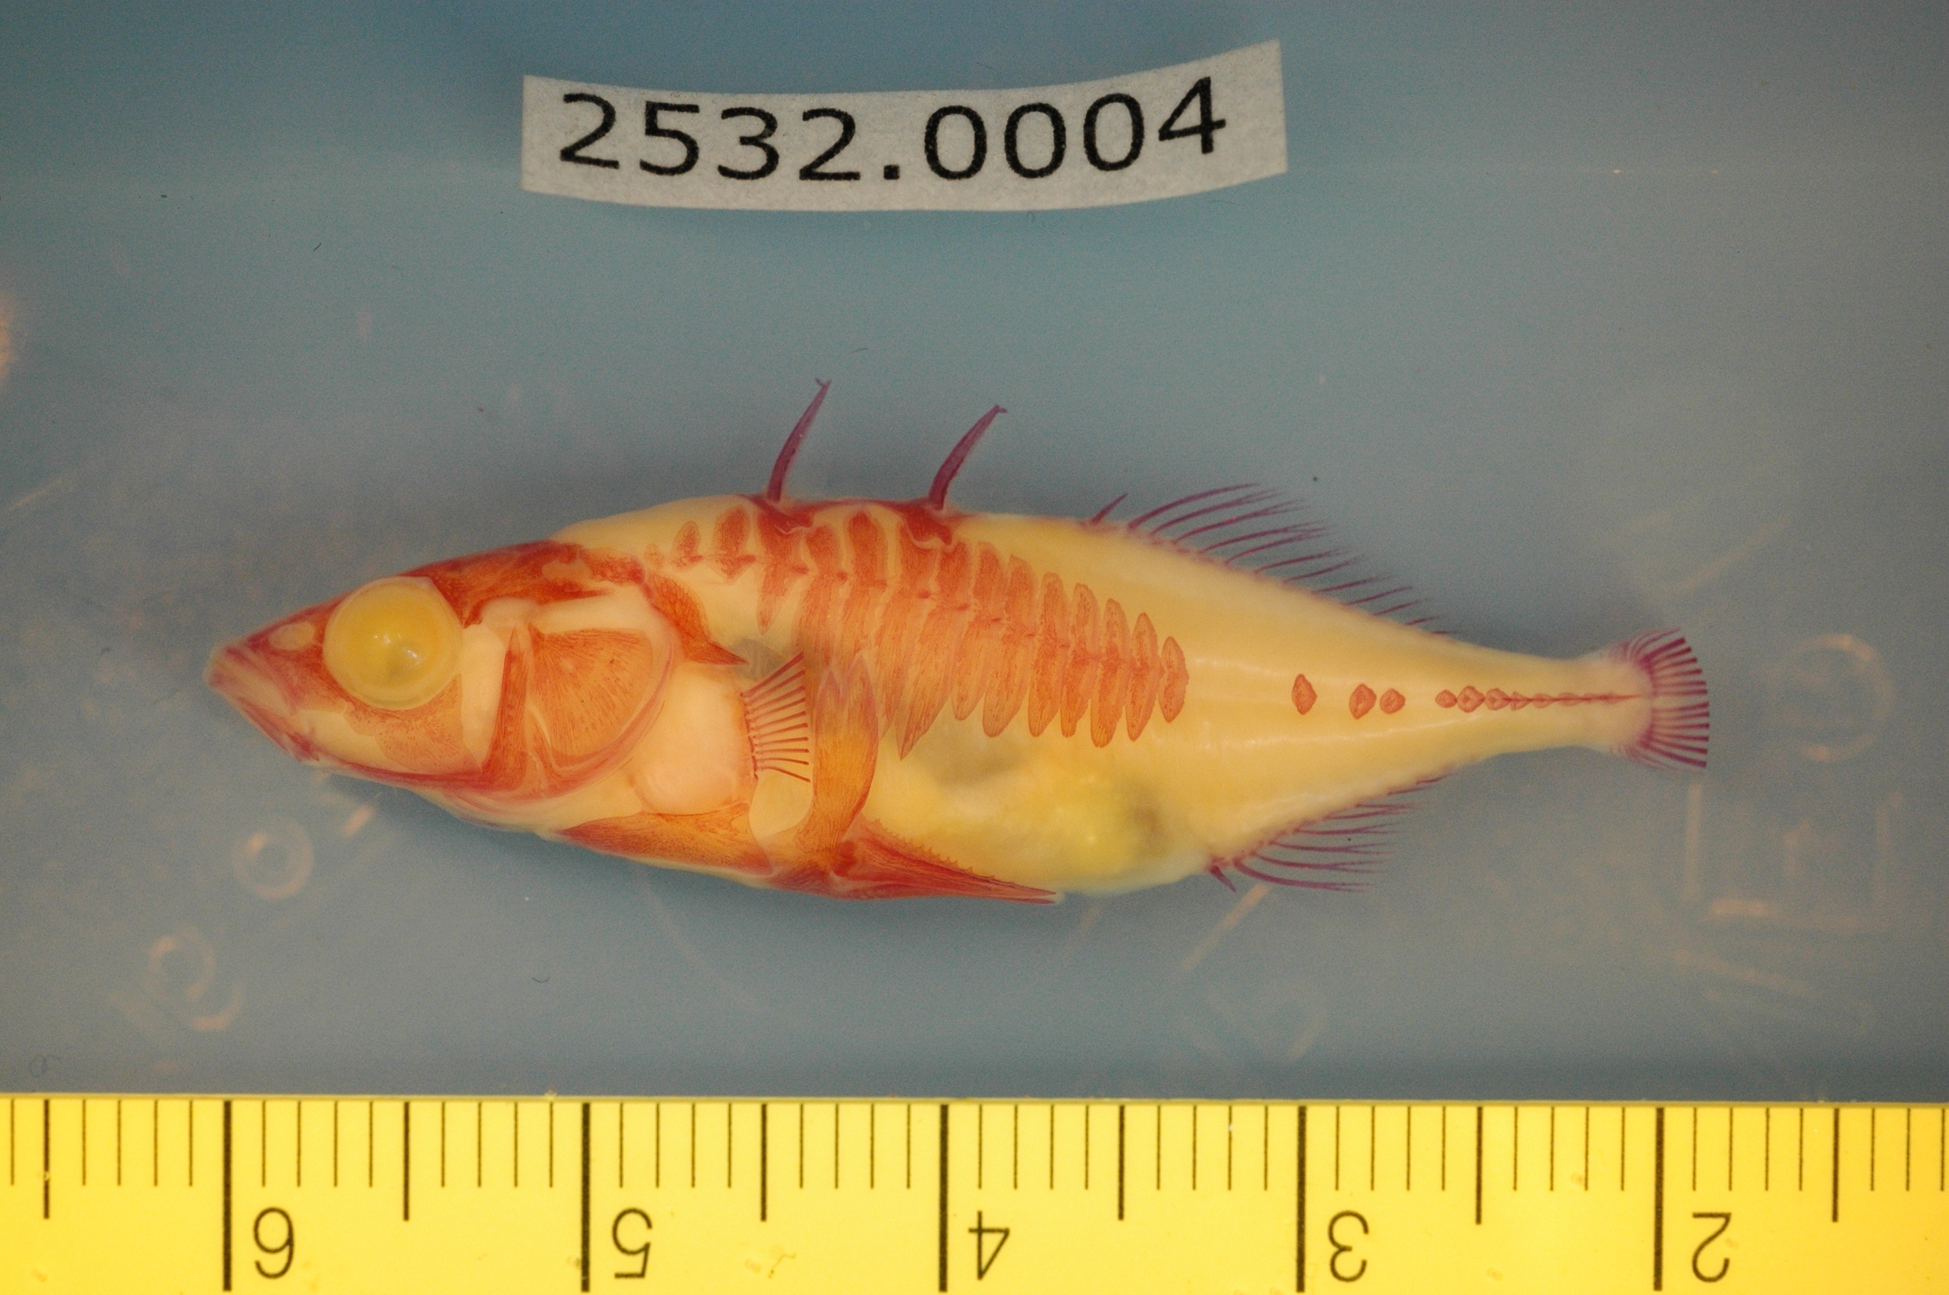
Confounders
Beyond the format of the data good datasets have limited irrelevant confounders
ML picks up on patterns, so you don’t want to add your own that might not be relevant to the question you’re asking
Columbia River
Riverbend

Slide 6
Confounders - Example
Study interested in understand Phenotype differences in two populations
Rulers placed in image for scale – Good for Consistency
ID numbers include in image – Good for reproducibility
Columbia River
Riverbend

Slide 7
Confounders - Example
Ruler color differs between collection site!
ID numbers differ between collection site
Both effects were learned by a classifier trying to predict the phenotype from the image!
Columbia River
Riverbend

Slide 8
Confounders - Lessons
You may need to clean your data before training an ML algorithm
Sometimes what's best for reproducibility is bad for ML algorithms
If you inject unique features into your data for each subject or experiment it can help you keep organized
Expect ML models to learn these features too! You’ll need to remove them before training.
This happens in other kinds of data too not just images
Columbia River
Riverbend

Slide 9
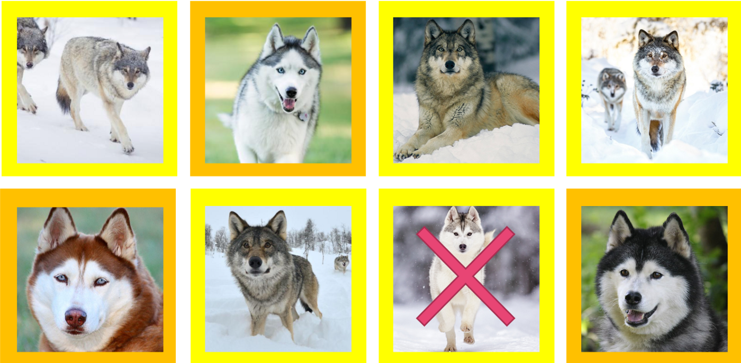
What’s the Confounder? Husky or Wolf
https://arxiv.org/abs/1602.04938

Slide 10
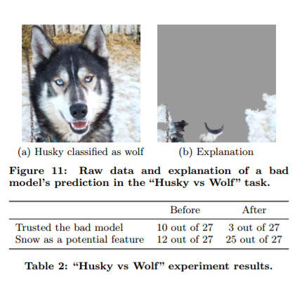
Confounders
Is it a problem?
https://arxiv.org/abs/1602.04938

Slide 11
How much data do you need for ML
A random answer on Quroa
At a bare minimum, collect around 1000 examples. For most "average" problems, you should have 10,000 - 100,000 examples.
Statements like this are common, and completely incorrect
Problem: There is no correct answer
ML finds patterns, the more obvious the pattern the less data you need
How good do you need your algorithm to work?
Better than people at something people are really good at like object recognition
A lot of data
Better than nothing
A little data
Do patterns exist?
If not then no amount of data will help

Slide 12
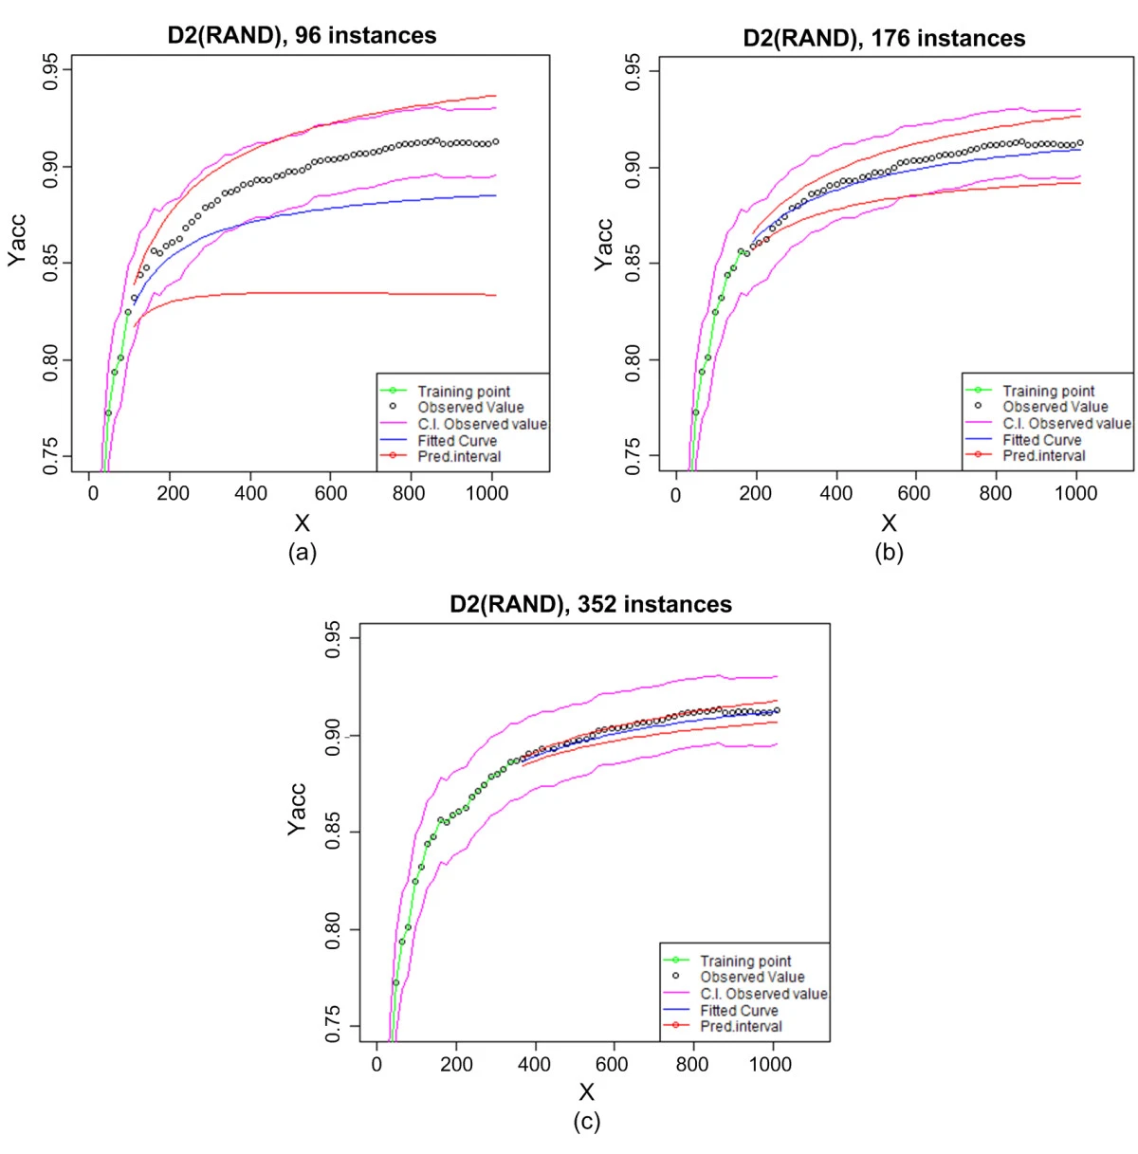
Learning Curves
Predicting sample size required for classification performance https://bmcmedinformdecismak.biomedcentral.com/articles/10.1186/1472-6947-12-8
You’ll need some data to estimate how much more you’ll need to reach a given accuracy
ML algorithms improve with data until they reach a saturation point
Can be useful to train models early in data taking to get an idea of how much more you’ll need to reach a certain goal

Slide 13
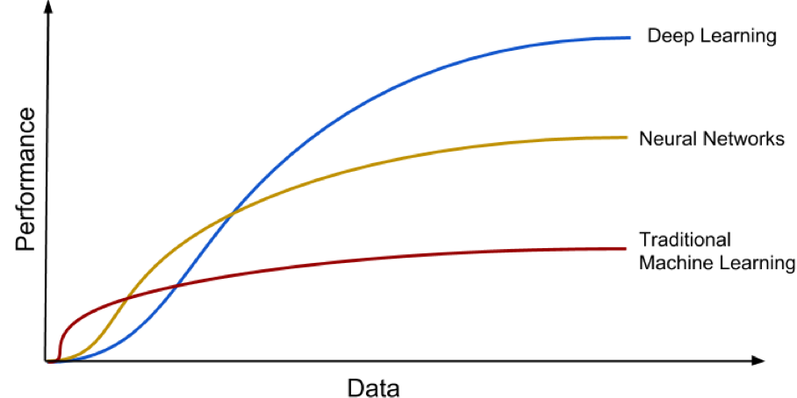
Models have different learning curves

Slide 14
Data Splits – How Much
Recommendation split data into 80% training 20% testing
What’s the tradeoff?
More testing data means better estimates of how well your model is working
More training data means the better your model works.
Another Recommendation – if this split doesn't give you enough testing data consider a different validation strategy
Cross-validation – K-Folds or leave one out
Both the above give you estimates of how well some models

Slide 15
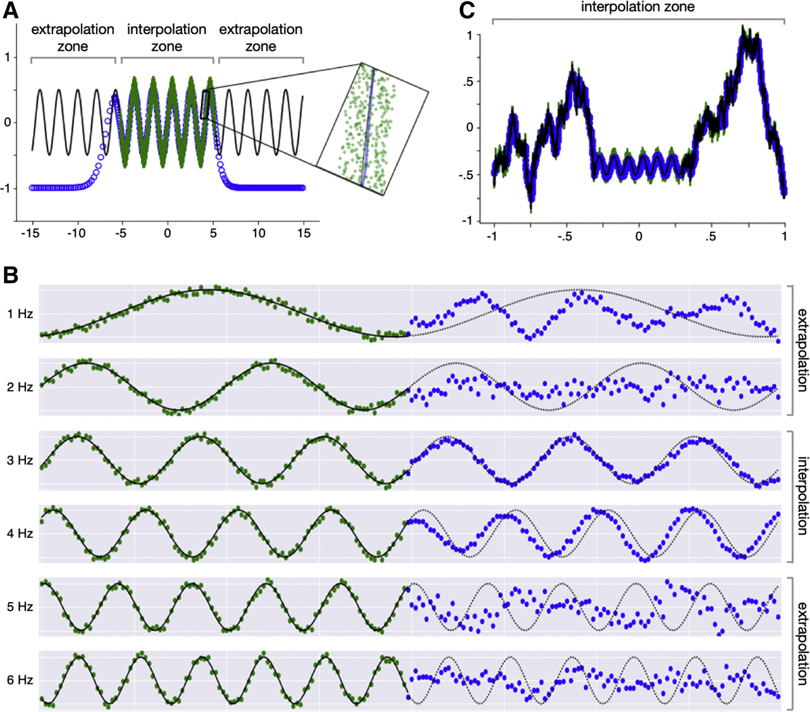
Extrapolation
ML does a lot of neat things, but it isn’t magic
Unless specified treat ML algorithms as universal function approximators
i.e. ‘Linear’ regression is not a universal function approximator
If you’re collecting data make sure you collect ’representative’ samples

Slide 16
Dataset Bias
ML classifiers and algorithms will do there best to learn what they see in there training data.
Example
Inputs: Room Temperature
Target: A random draw from a bag with 5 red balls and 5 green balls
This Input is completely un-related a well trained ML model will predict probabilities of ~50% red ~50% green
Example 2 – Same except
Target: A random draw from a bag with 10 red balls and 5 green balls
A well-trained ML model will predict probabilities of ~66% red ~33% green
If we turn our probabilities into decisions by using the >0.5 rule
Case 1: >50% is probably still random equal prediction of red and green
Case2: Red is always > 50% prediction is red all the time
When we train a model we get to decided what data we include
We can balance the classes, leave them as is, or over-sample a class
In our random example above this lets us pick an ML output anywhere from 100% red to 100% green
Whenever there is uncertainty your class balance will change your result!
Be-careful about think of these results as the truth. Think of it as the truth of the training data you selected

Slide 17
ML Experiment
Define your problem
Gather preliminary or existing data
Fit a test model
Use a learning curve fit to estimate how much more data you might need
Use importance or attribution to look for confounders that might affect your data
Gather data and experiment with new models
Deploy/Publish – Return to 6

Slide 18
Case Study: Why Amazons Automated Hiring Tool Discriminated Against Women
2014 Amazon built a model to read resumes and predict who will be successful
Inputs: Resume Terms
Outputs: Hired/Not Hired
Uncertainty in hiring is large
Dataset was historical and very Male – Gender was excluded so in theory the model shouldn’t know
Confounders – “downgraded resumes that included the word “women’s” — as in “women’s rugby team.””
In search of objectivity the model reproduced the training data’s gender bias
The model was scraped before put into production
https://www.aclu.org/blog/womens-rights/womens-rights-workplace/why-amazons-automated-hiring-tool-discriminated-against

Slide 19
Conclusions and Homework
Conclusions
It’s important to think about:
Possible confounders
Dataset bias and balance
Are you going to use your model on new data that isn’t representative in your training data
Homework:
1. Use penguins.csv to make a histogram of body mass by species
2. Train a Random Forest Classifier from penguins.csv to predict species
Split dataset
Select numeric predictors
Fit a random forest.

